Slide 1
HEAL’s campaign on coal and health in Europe
www.env-health.org
@ClimateAirHEAL www.facebook.com/pages/HEALs-European-coal-and-health-campaign-Be-part-of-it

Slide 2
UN climate negotiations

Slide 3
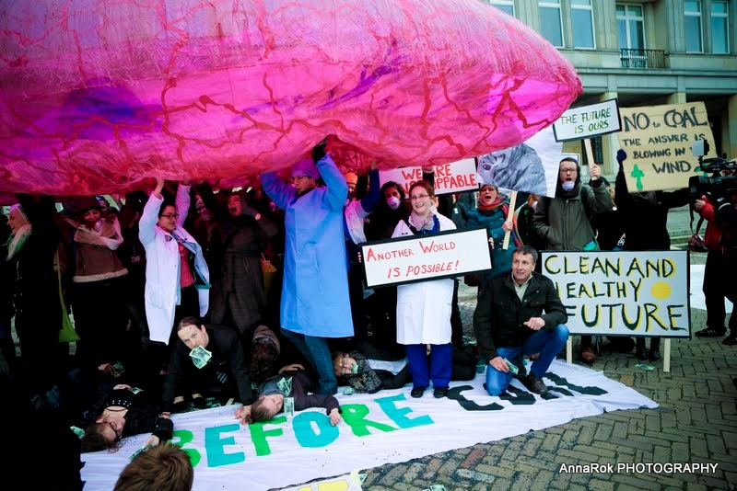
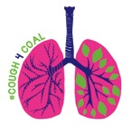
Warsaw COP 19 facebook.com/cough4coal

Slide 4
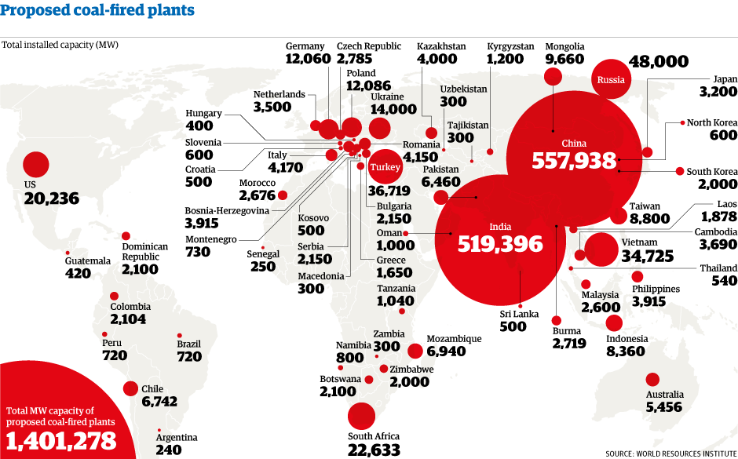
EU: less than 50 new plants in the pipeline Turkey: around 80

Slide 5
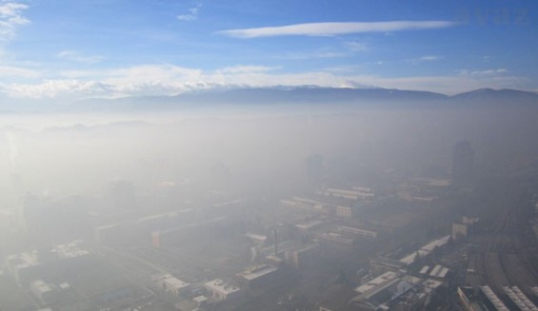

Slide 6
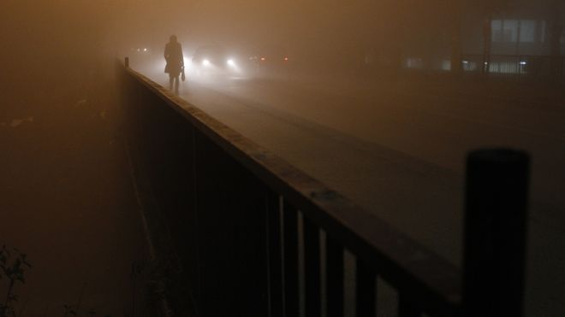

Slide 7
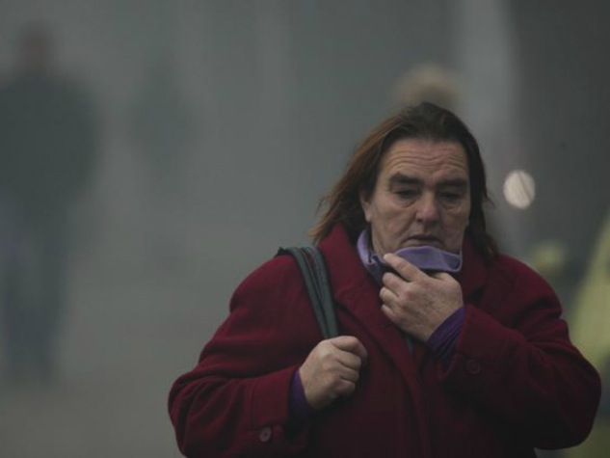

Slide 8
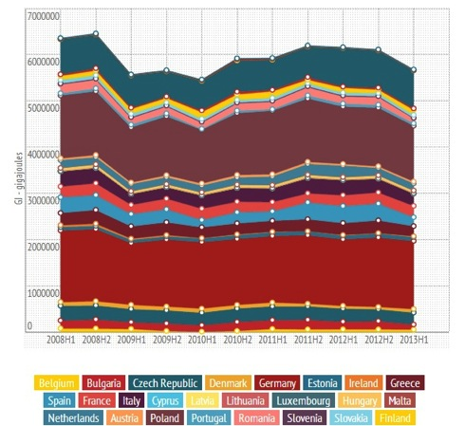
Coal renaissance in Europe? - world coal price low - shalegas boom (USA) - energy autonomy

Slide 9
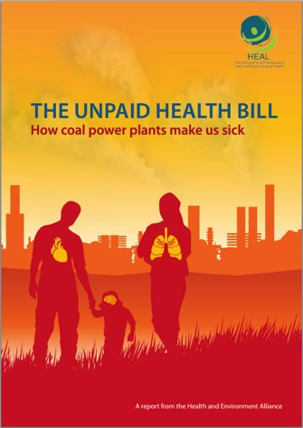
What does coal pollution cost our health? - 18,200 premature deaths
5,500 hospital admissions
8,500 cases of bronchitis
15.5 - 43 billion Euro health costs

Slide 10
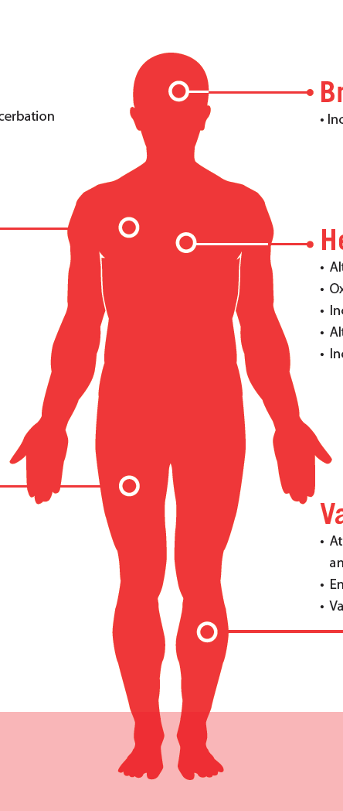
Brain
Increased cerebrovascular ischemia
Lungs
Heart
Accelerated progression and exacerbation of COPD
• Increased respiratory symptoms
• Reduced lung function
Higher lung cancer risk
Altered cardiac autonomic function
Oxidative stress
Increased myocardial ischemia
Blood
Reduced oxygen saturation
• Peripheral thrombosis
Atherosclerosis
Hypertension
Vasculature
Source: HEAL 2013, adapted from APHEKOM 2012, Pope & Dockery 2006

Slide 11
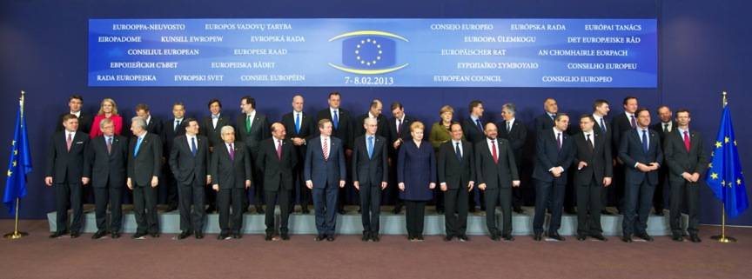
Will they change?

Slide 12
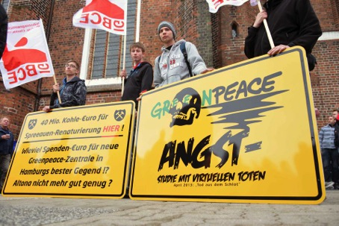
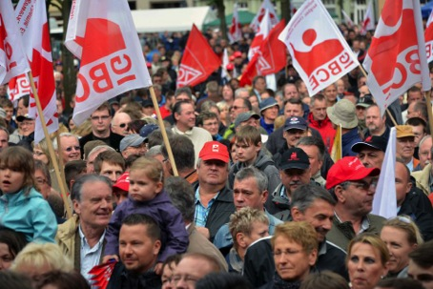
Will they change?

Slide 13
Health and Environment Alliance (HEAL)
28, Blvd. Charlemagne
B-1000 Brussels
julia@env-health.org
www.env-health.org
@ClimateAirHEAL www.facebook.com/pages/HEALs-European-coal-and-health-campaign-Be-part-of-it

