Slide 1
Healthy Planet UK 1-2 March 2014
Population, Sustainability and Reproductive Rights
Population & Sustainability: Stephen Bown
www.populationmatters.org
Reproductive Rights: Felicia Yeung
Medsin-UK Director of Branch Affairs
www.medsin.org

Slide 2
Population, Sustainability and Reproductive Rights
Aim of Workshop:
To raise the profile of population numbers in the debate on climate change and global health

Slide 3
Global Health, Population & Sustainability
Climate change is the greatest threat to global health in the 21st century
(Lancet 2009)
It is extremely likely that human influence has been the dominant cause of the observed warming since the mid-20th century (IPCC).
Which Human activities are most to blame?

Slide 4
Intergovernmental Panel on Climate Change (IPCC) 2000
Focused on speed of development
Level of technological Innovation
Adaptation to low carbon energy & consumption
Population was hardly considered.
WHY NOT?

Slide 5
el
Population Growth
“The elephant in the room….. ….that nobody talks about”

Slide 6
Population growth through the ages
170 million to 7 billion!
(X40 increase in 2000 years)
One dot =
1 million people
Each dot
= 1 million
people

Slide 7
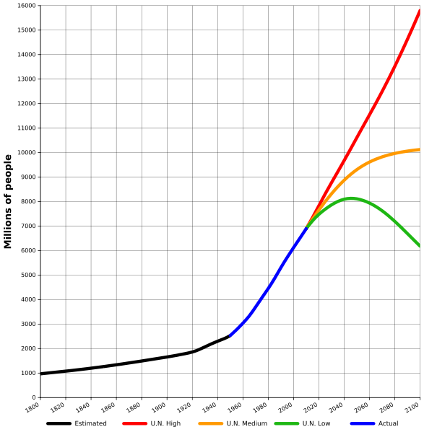
World population – past and future (UNDESA)
16 billion
10 billion
6 billion

Slide 8
What about the UK? (UK ONS – Office for National Statistics)
10 New Birminghams in the next 20 years
DOES IT MATTER?
YouGov poll in 2011 80% said yes.
Year | Population
1911 | 42 million
2001 | 59 million
2011 | 63 million
2030 (Projected) | 73 million

Slide 9
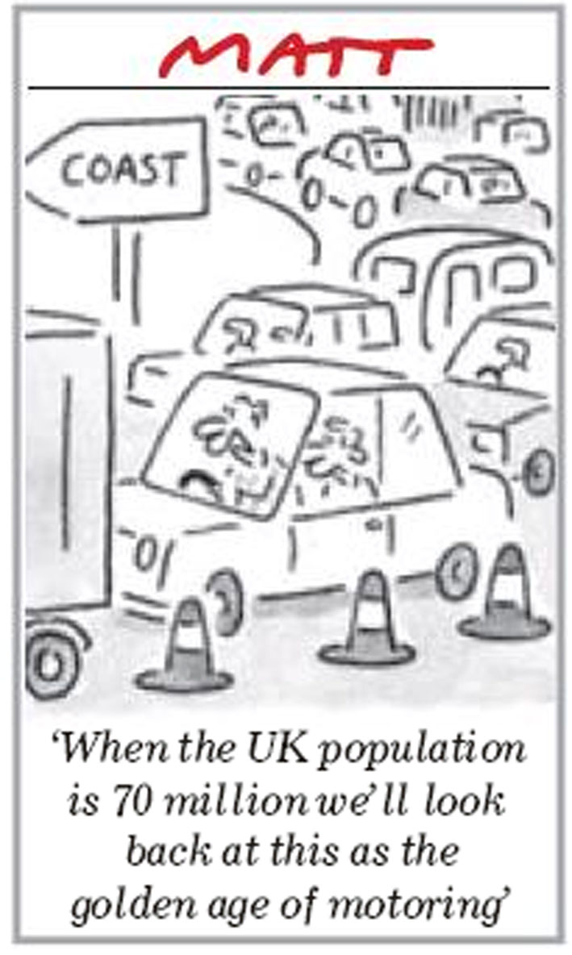

Slide 10
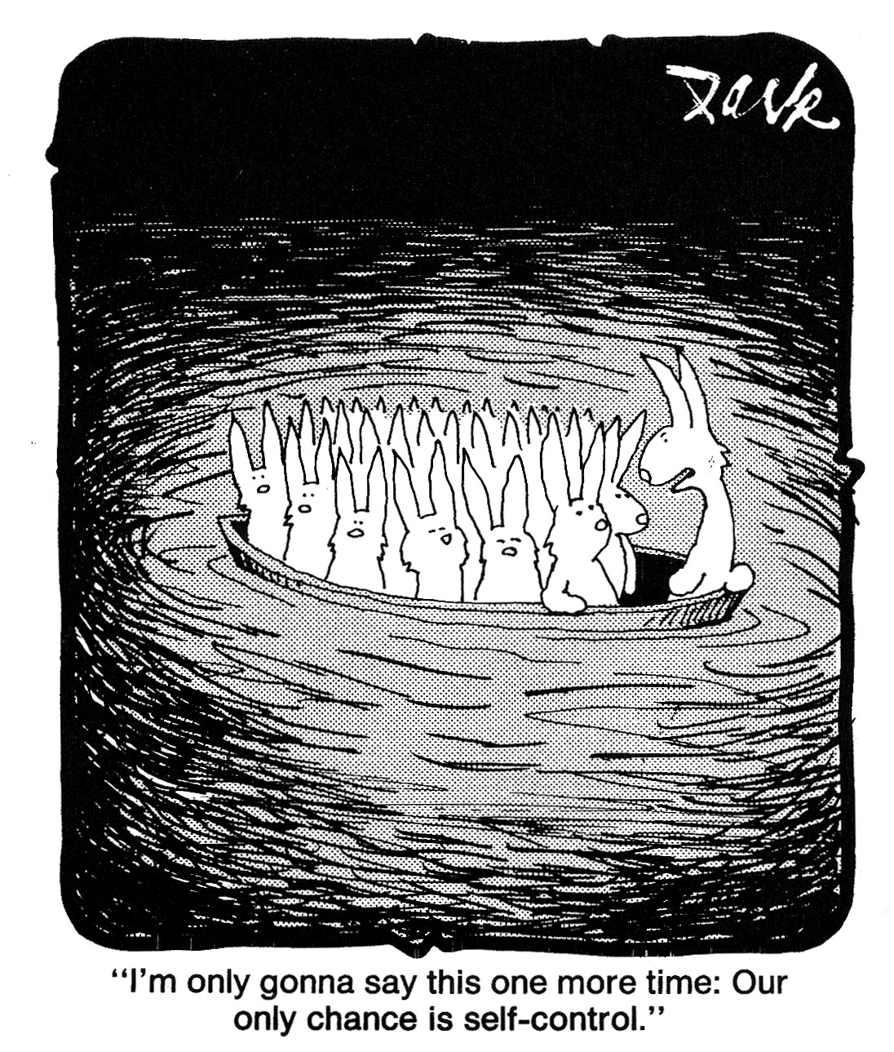

Slide 11
What determines how many people the Earth can support?
The quality of life that is considered acceptable
What we eat & drink
On a vegetarian diet, larger numbers can be fed
What we do
Restraint in the use of irreplaceable resources
The balance between humans and all other animal and plant life
In the natural balance of nature, any major changes are made at our peril

Slide 12
Consequences of more people and over consumption Threats to limited resources
Water
Agricultural land area
Fish stocks (freshwater and sea)
Energy from fossil fuels
Mineral and plant resources
Biodiversity and wild life habitats

Slide 13
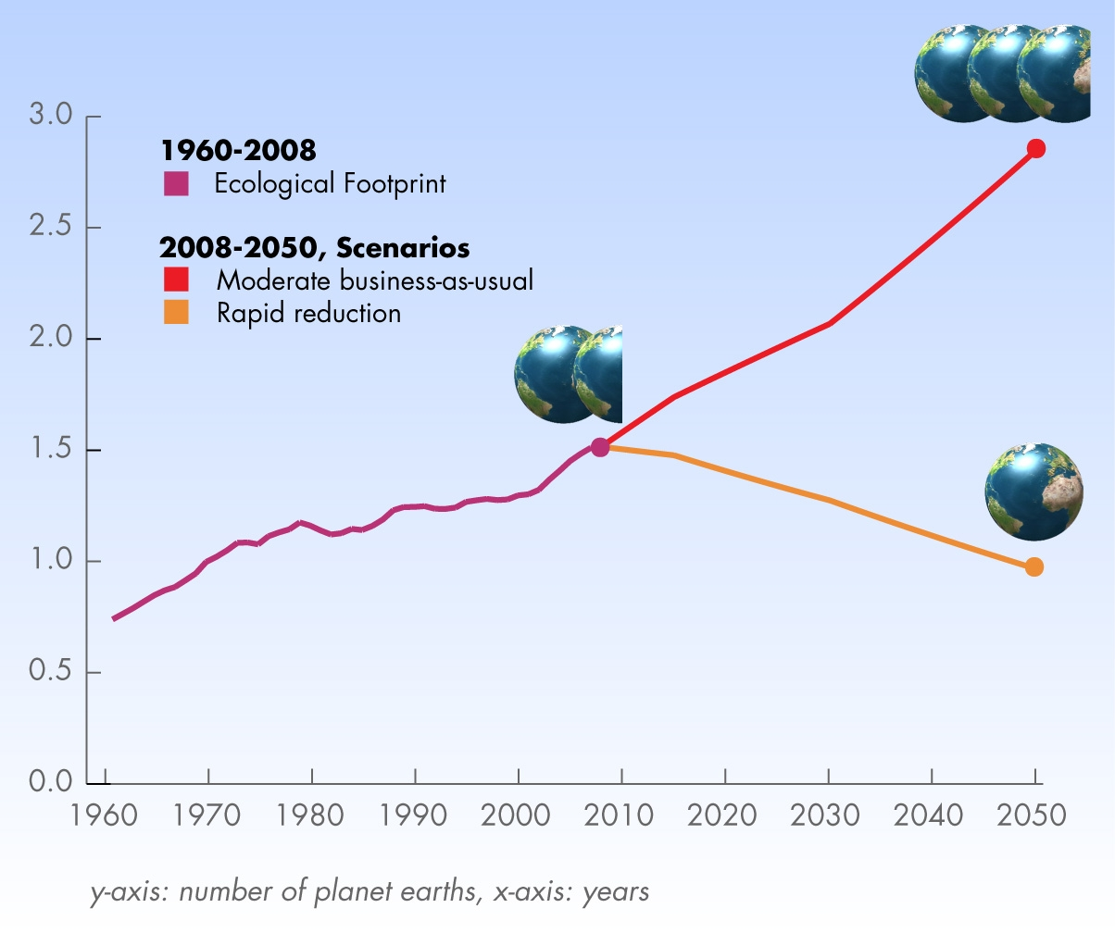
How many people can the planet support?
Global Footprint Network www.footprintnetwork.org/

Slide 14
WHAT CAN TECHNOLOGY DO?
Reduce dependence on fossil fuels
Reduce energy consumption
Increase efficiency of food production & distribution
Manage the use of water
How well can technology compensate for the negative pressures of over population and over consumption?

Slide 15
Equating impact of one extra person to reducing consumption by existing individuals
Practical, available, environmentally-friendly’ actions to reduce consumption:
Fuel-efficient car; halving annual car mileage; fitting double glazing and low-energy light-bulbs; recycling all paper, tin and glass - individual over their lifetime could curb carbon budget by
486 tonnes of carbon (from a typical value of 1656 tonnes, 30%)
• By a decision to have one less child, a woman and her family would save
9,441 tonnes of carbon (includes emissions of descendants).
20 x amount saved from all other eco-actions combined!
http://www.biologicaldiversity.org/campaigns/overpopulation/pdfs/OSUCarbonStudy.pdf

Slide 17
People and the Planet (Royal Society report 2012)
Rapid and widespread changes in the world’s human population, coupled with unprecedented levels of consumption present profound challenges to human health and wellbeing, and the natural environment.

Slide 18
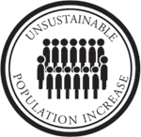
Threats to our environment Two sides of the same coin
no. of
per
person
persons

Slide 19
Consumers cause climate change!
Who sins most?
Affluent individuals and organisations, mainly in the global north
Who suffers most?
Those who have least, mainly in the global south

Slide 20
What will make a difference?
Short term:
REDUCING CONSUMPTION by the AFFLUENT
Medium and long term:
REDUCING CONSUMPTION by the AFFLUENT
REDUCING POPULATION SIZES
REDUCING INEQUALITIES BETWEEN RICH & POOR
Birth rate must be reduced NOW for sustainable population levels in the future

Slide 21
Animal populations are controlled by:
Food availability; Disease prevalence
Procreation level; Predation
and stabilize at sustainable levels
Human populations are controlled by:
Procreation, Famine, Disease, War
How long can human ingenuity (or is it stupidity) prevent nature taking over if we don’t acknowledge and change what we are doing?

Slide 22
What percentage of the mass of vertebrate animals in the world is human beings?
5% ?
15% ?
25% ?

Slide 23
What percentage of the mass of vertebrate animals in the world is human beings?
25%

Slide 24
What percentage of the mass of vertebrate animals in the world is animals bred for human benefit?
35% ?
50% ?
65% ?

Slide 25
What percentage of the mass of vertebrate animals in the world is animals bred for human benefit?
65%
25 + 65 = 90
YES. 90% of vertebrate mass on earth is humans or animals bred for human benefit

Slide 27
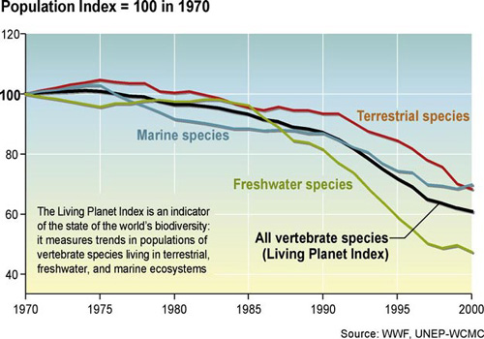
Biodiversity loss
Biodiversity loss

Slide 28
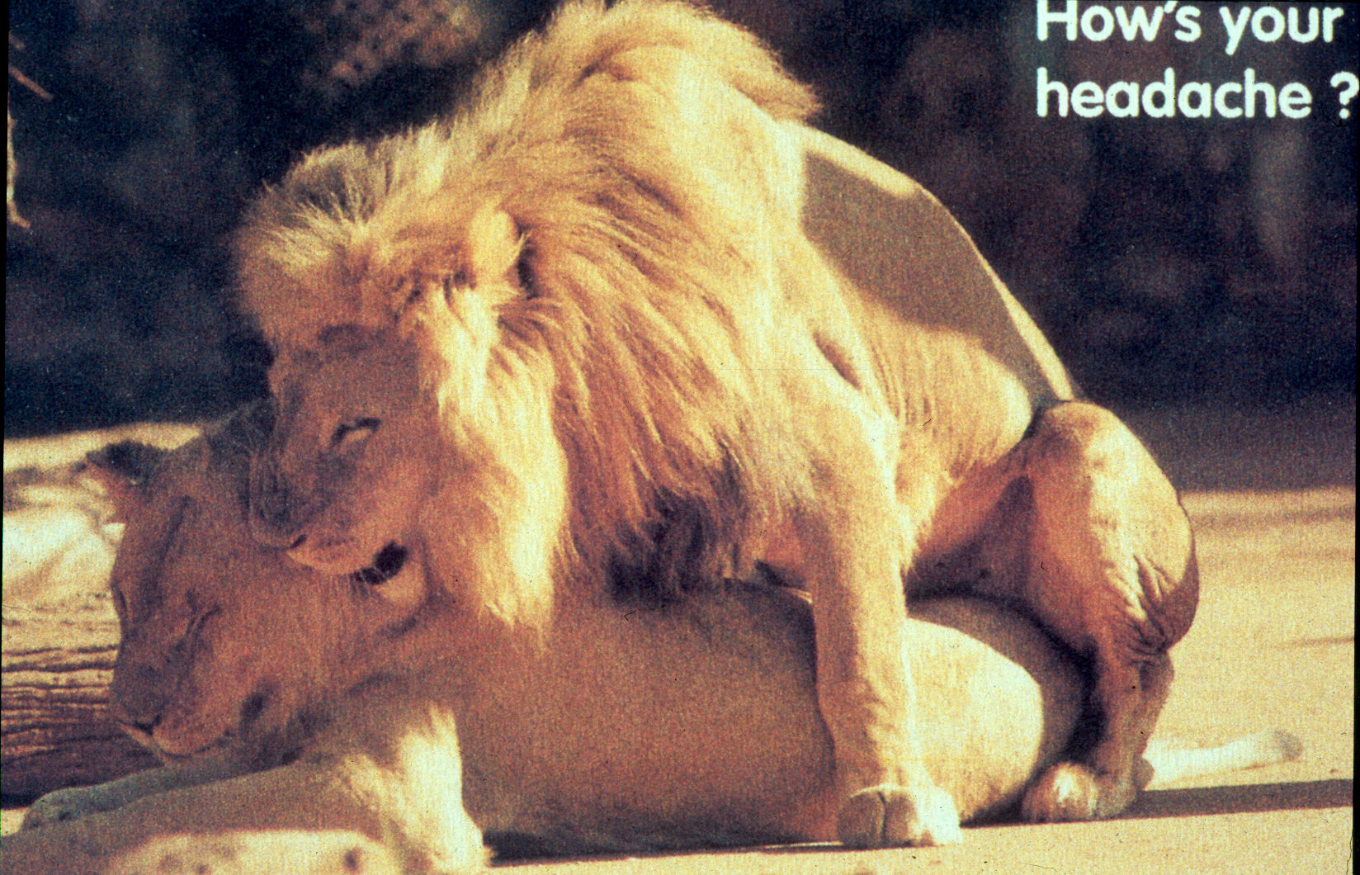

Slide 29
Poverty
Oxfam was founded in 1947 to alleviate poverty
2 billion people today have an income of less than U.S. $2.5/day.
This is comparable to the total global population in 1947
WHAT SORT OF PROGRESS IS THIS ON ALLEVIATING POVERTY?

Slide 30
Ignoring over population is like rearranging the deckchairs on the Titanic

Slide 31
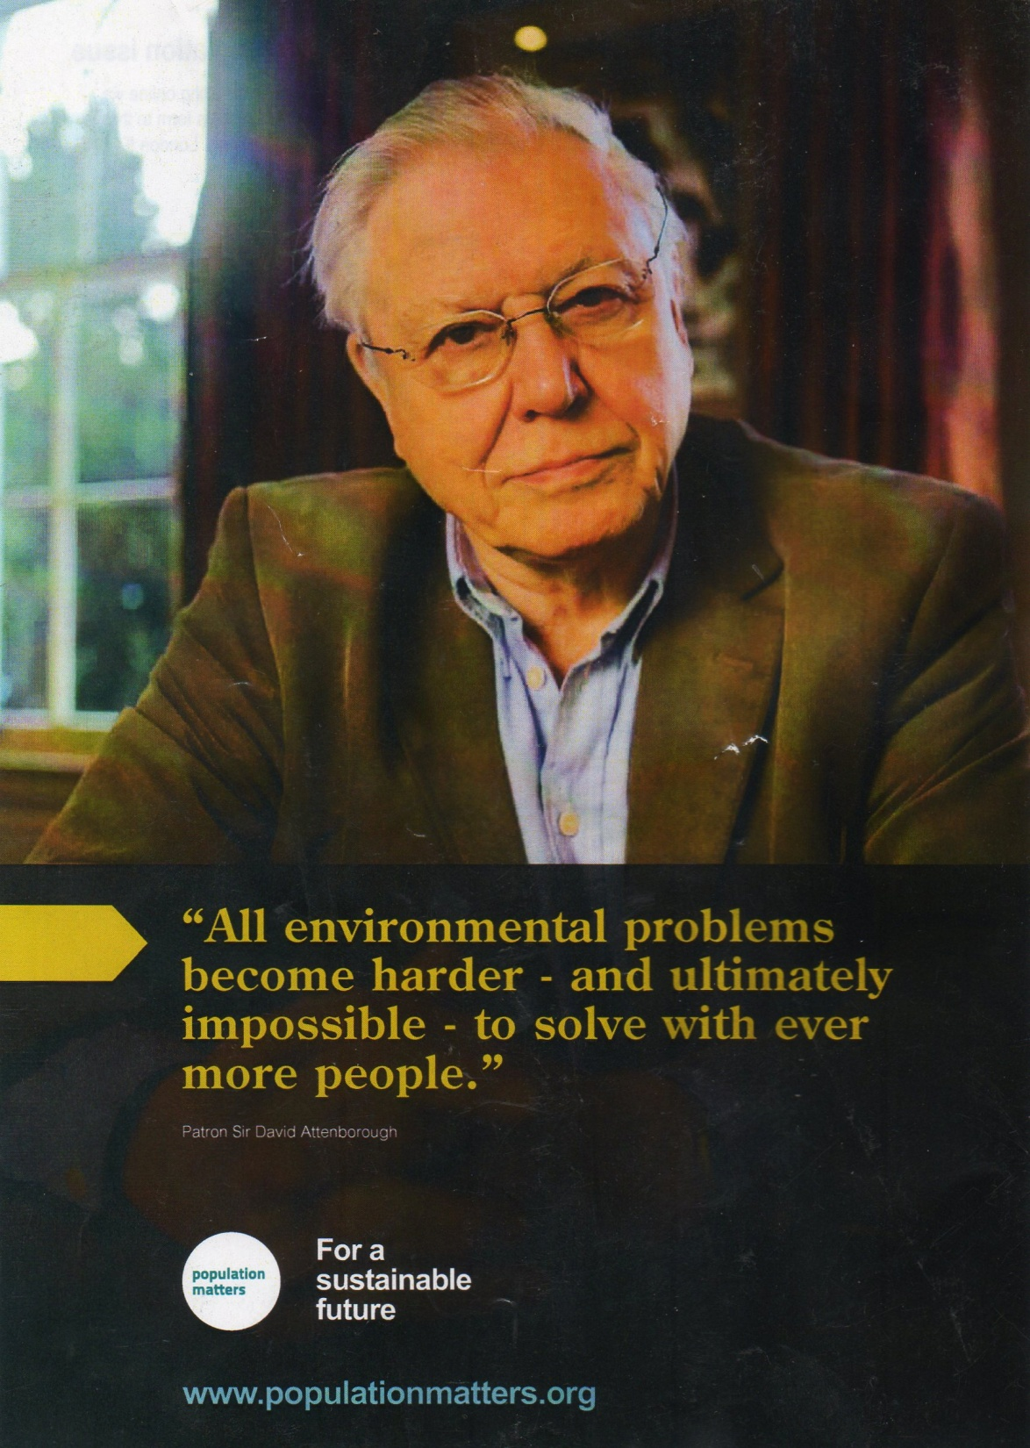

Slide 32
SO WHERE ARE WE NOW?
World population is slowly stabilising, but to a level where it would be difficult to maintain a good quality of life for all
With appropriate motivation, a sustainable number can be achieved, but over several generations
This requires reducing consumption AND the number of children being born NOW

Slide 33
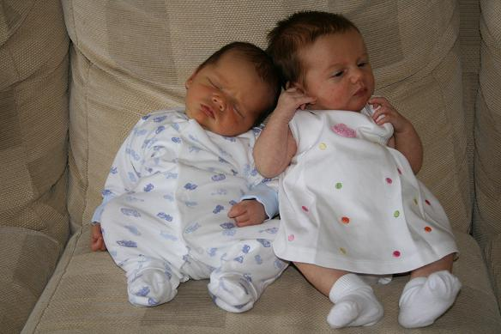
Every child has a right to be wanted, healthy, well educated, happy, to have a rewarding life and to be able to anticipate the same for their own children
It can only happen if population and consumption are stabilised at sustainable levels
Notes:
Isabella my grand-daughter is the one on the right, other is cousin Archie! We love them to bits.
Point is that there will be more humanity in the world if there are fewer humans than there look like being, all desperately competing (and planet being finite).

Slide 34
Climate Change & International Politics
Regulation and implementation has achieved little due to:
Uncertainties about science
PRECAUTIONARY PRINCIPLE:
Uncertainty is not necessarily a reason to avoid or postpone action
Large economic costs of change
Threats to vested interests

Slide 35
The Doctor’s Dilemma
“In my view it is morally questionable to intervene in death without at the same time intervening in birth”
Tim Dyson, Professor of Population Studies, London School of Economics

Slide 36
Questions for Discussion
Why are people so reluctant to talk about population numbers?
How sustainable are we now?
How well can technology keep up with increases in population & consumption?
How easy is it to influence population and consumption?

Slide 37
QUIZ
WHO SAID WHAT?

Slide 38
George Carey Archbishop of Canterbury 1991-2002
"The overpopulation of this small island nation, already stricken with a mountain of debt that could blight generations, is the gravest crisis we face."

Slide 39
Nicolas Machiavelli writer 1469 – 1527
"When every province of the world so teems with inhabitants that they can neither subsist where they are nor remove themselves elsewhere… the world will purge itself in one or another of these three ways (floods, plague and famine)."

Slide 40
Albert Einstein
"Overpopulation in various countries has become a serious threat to the health of people and a grave obstacle to any attempt to organize peace on this planet."

Slide 41
"What becomes of the surplus of human life? It is either, first, destroyed by infanticide or, second, it is stifled or starved, as among nations whose population is commensurate to its food; or, third, it is consumed by wars and endemic diseases; or fourth, it overflows, by emigration, to places where a surplus of food is attainable."
James Madison
US President 1809-1817

Slide 42
Kenneth Boulding (economist & environmental advisor to President Kennedy)
"Anyone who believes in indefinite growth of anything physical on a physically finite planet is either a madman or an economist."

Slide 43
Goodluck Jonathan President of Nigeria
"For us to plan properly, we must manage our population..

Slide 44
Sir David Attenborough
“We (the human race) are a plague on the Earth”

Slide 45
Pope Paul VI (Pope 1963-1978)
"There is no denying that the accelerated rate of population growth brings many added difficulties to the problems of development where the size of the population grows more rapidly than the quantity of available resources. In such circumstances people are inclined to apply drastic remedies to reduce the birth rate….. it is for parents to take a thorough look at the matter and decide upon the number of their children.”

Slide 46
Kofi Annan UN Secretary-General 1997-2006
"The idea that population growth guarantees a better life, is a myth that only those who sell nappies, prams and the like have any right to believe." "Population stabilisation should become a priority for sustainable development, including a strong focus on the empowerment of women and girls."...reproductive health (is) one of the key tools in the wider battle against poverty."

Slide 47
Chris Packham Naturalist and broadcaster
"There's no point bleating about the future of pandas, polar bears and tigers when we're not addressing the one single factor that's putting more pressure on the ecosystem than any other — namely the ever-increasing size of the world's population."

Slide 48
Martin Luther King
"Unlike plagues of the dark ages or contemporary diseases we do not yet understand, the modern plague of overpopulation is soluble by means we have discovered and with resources we possess. What is lacking is not sufficient knowledge of the solution but universal consciousness of the gravity of the problem and education of the billions who are its victims."

Slide 49
Prince William - Duke of Cambridge
"(We're) thinking about having two (children)."

Slide 50
Things to do
Talk to everyone about over population and over consumption
Ask them what the consequences might be and what could be done to minimise the effects
How many children would they like?
What is a good age to start a family?
What action(s) would be most effective to stabilise the situation:
Reduce per capita consumption in affluent countries?
Reduce birth rate in developing countries?
Reduce birth rate in affluent countries?
All the above…..?

